Slide 1
A Diabetes Detection using Machine Learning
Shanu Sharma Mam^{a*}, Saransh Chauhan^{b}, Sawan^{c},
, Shobhit Sinha^{d}
ª Associate Professor, Dept. of CSE ABESEC, Ghaziabad, U.P., India
^{b, c, d} Student, B.Tech. Dept. of CSE ABESEC, Ghaziabad, U.P., India

Slide 2
1. Objective
i)The primary aim of this project is to analyse the Diabetes Dataset and use Support Vector Machine, K-Nearest Neighbors & Decision Tree algorithms for prediction.
ii)Allow users to predict diabetes utilizing the prediction engine.
iii)The objective is set to achieve the aims of the project through a Research on statistical models in machine learning and to understand how the algorithms works

Slide 3
1.1 Motivation
Diabetes is a chronic disease that can pose a global public health crisis. Diabetes mellitus, or diabetes, is a disease caused by elevated blood sugar levels. It is one of the most deadly diseases on the rise worldwide.
Various traditional methods based on physical and chemical examination are available for diagnosing diabetes. Data science techniques have the potential to benefit other scientific disciplines by shedding new light on frequently asked questions. Machine learning is a new branch of data science that deals with how machines learn from experience.
This study focuses on recent developments in machine learning that have had a significant impact on diabetes detection and diagnosis. We also aim to propose an effective method for early detection of diabetes.

Slide 4
2.1 Literature Survey
Dr. Saravana Kumar N.M., Eswari, Sampath P. and Lavanya S. (2015) implemented a system to analyze diabetes data using Hadoop and Map-Reduce techniques. This system predicts diabetes types and associated risks. This system is based on his Hadoop and is economical for any medical institution.
Aiswarya Iyer (2015) used classification techniques to explore hidden patterns in diabetes datasets. Naive Bayes and decision trees were used in this model. The performance of both algorithms was compared, which showed the effectiveness of both algorithms .
K. Rajesh and V. Sangeetha (2016) used a classification method. They used his decision tree algorithm to find hidden patterns from datasets for efficient classification .
Humar Kahramanli and Novruz Allahverdi (2018) used artificial neural networks (ANNs) combined with fuzzy logic to predict diabetes

Slide 5
Continued…
BM Patil, RC Joshi, and Durga Toshniwal (2010) proposed a hybrid prediction model involving a simple k-means clustering algorithm and then applying a classification algorithm to the results of the clustering algorithm.
The C4.5 decision tree algorithm is used to create the classifier. [10] Mani Butwall and Shraddha Kumar (2015) proposed a model to predict diabetes behavior using a random forest classifier.
[7] Nawaz Mohamudally1 and Dost Muhammad (2011) used C4.5 decision tree algorithm, neural networks, K-means clustering algorithm and visualization to predict .

Slide 6
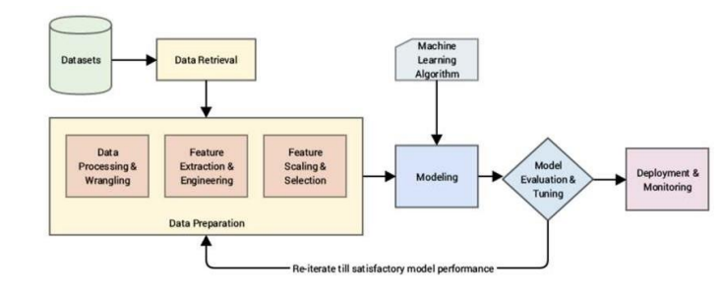
3 Methodology And Setup of Experiment

Slide 7
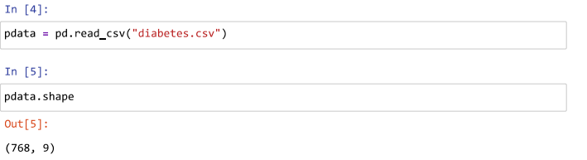
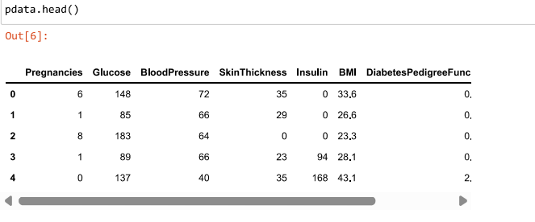

Slide 8
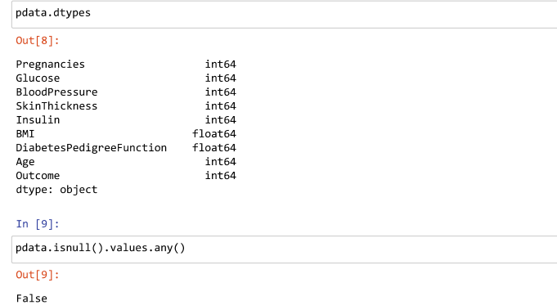

Slide 9
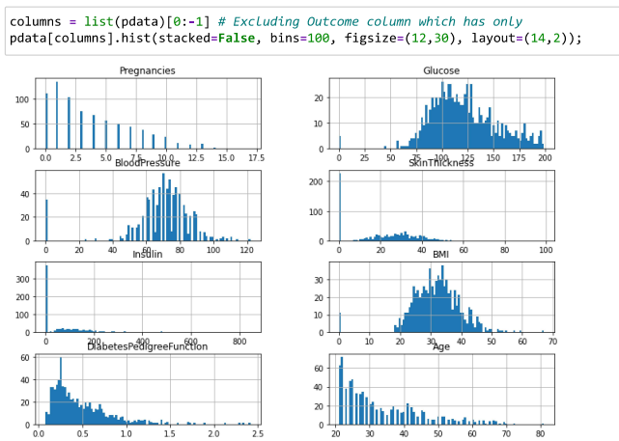
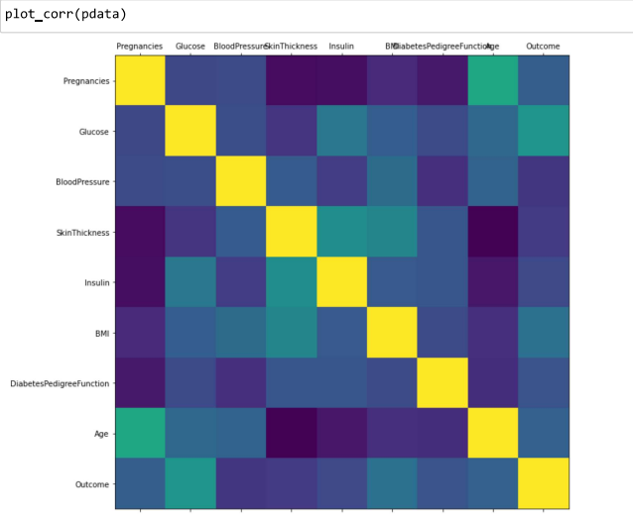

Slide 10
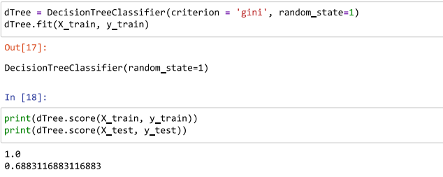
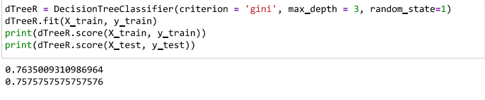

Slide 11


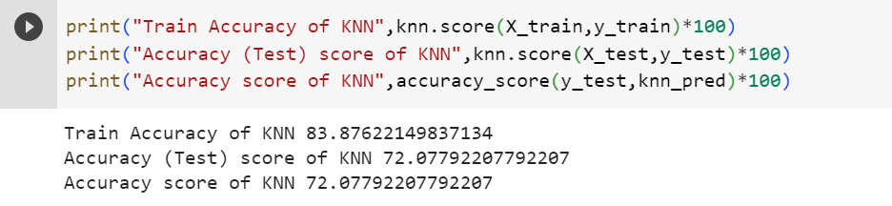

4. Summary Of Results
For KNN the accuracy achieved after training was 72 percent.
.

Slide 12
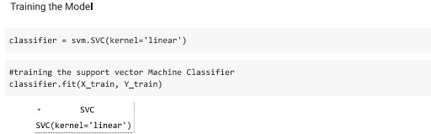
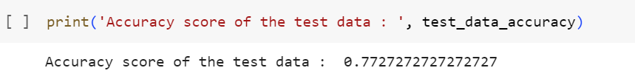
For SVM the accuracy achieved after training was 77 percent.

Slide 13
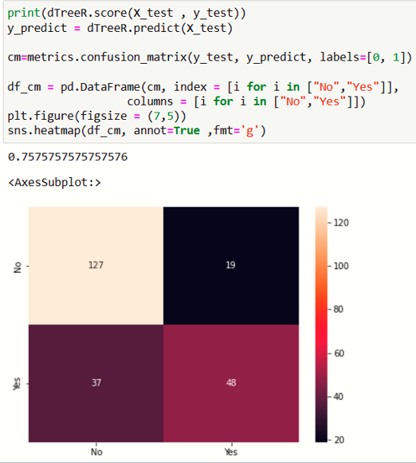
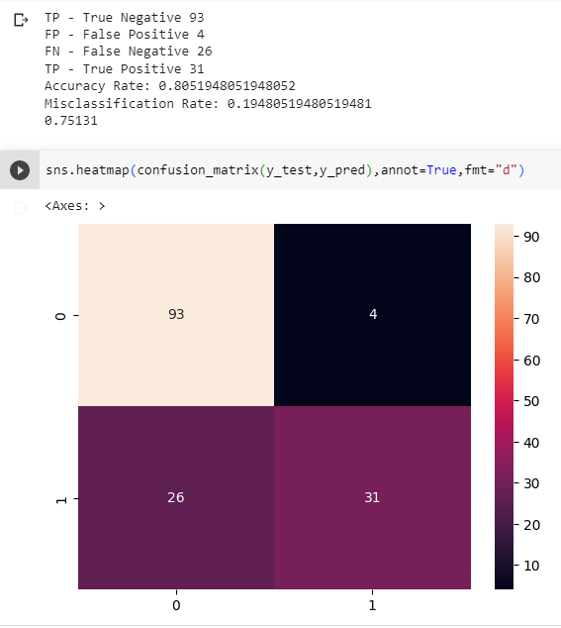
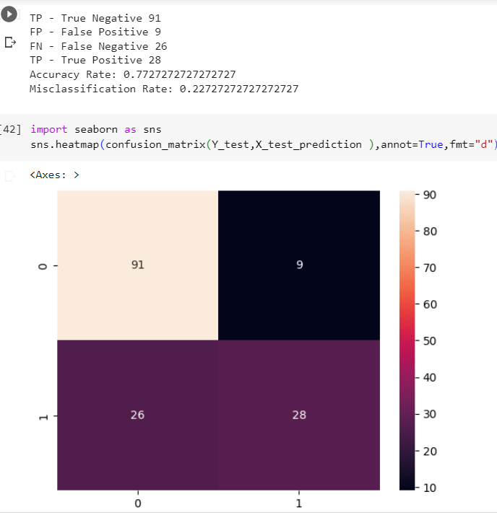
CONFUSION MATRIX DECISION TREE
CONFUSION MATRIX KNN
CONFUSION MATRIX SVM

Slide 14
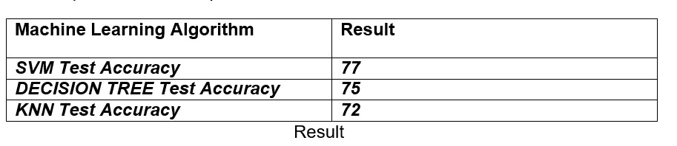
Conclusion
In this study, various machine learning algorithms were applied to the data set to Classification was performed with different algorithms. It is observed that the accuracy achieved throught the use of SVM was 77 percent, accuracy using Decision Tree was 75 percent and accuracy achieved through KNN was 72 percent. Of these, SVM has the highest accuracy of 77%. We compared the accuracy of machine learning algorithms using same dataset. It is clear that models using this dataset improve the accuracy and precision of diabetes prediction compared to existing datasets. Additionally, this study could be extended to examine the likelihood that non-diabetics will develop diabetes in the next few years.

Slide 15
6. References
[1] https://www.kaggle.com/datasets/uciml/pima-indians-diabetes-database
[2] Komi.zhai.2019.Application of Data Mining Methods in Diabetes Prediction .
[3] Witten , Ian H., et al. Data Mining :Practical machine learning tools and techniques. Morgan Kaufmann,2020
https://en.wikipedia.org/wiki/Bin_ary_classification

Slide 16


